Slide 2
Perioperative Management of Anticoagulant Drugs (NOACs)
Rasoul Azarfarin MD, FACC
Rajaie Cardiovascular Medical & Research Center
Nov 2019

Slide 3
Warfarin (in heart valve prosthetics)
Stop Warfarin 2-3 days before minor procedures (and change to heparin or LMWH); restart 12-24h postoperatively.
Stop Warfarin 5 days before major procedures restart 48-72h postoperatively.
Stop heparin 4-6h or LMWH 12h before procedure and restart after local hemostasis.
Adjust Warfarin dose to reach INR to 2.5 in Aortic valve prosthesis and 3 in Mitral valve prosthesis.

Slide 4
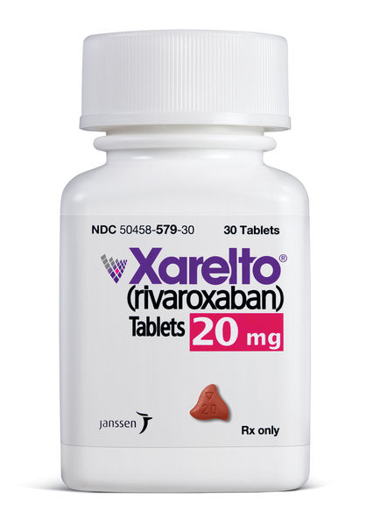
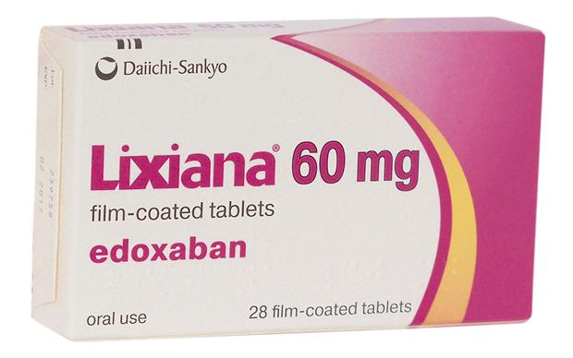
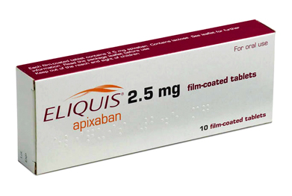
Non-vitamin K antagonist oral anticoagulants

Slide 5
Coagulation cascade

Slide 6
Non-VKA direct oral anticoagulants (NOACs)

Slide 7
Procedural bleeding risk

Slide 8
Procedural bleeding risk

Slide 9
Non-VKA direct oral anticoagulants (NOACs)
In patients treated with NOACs:
‘on’ and ‘off’ action, ‘bridging’ to surgery is in most cases unnecessary, due to their short biological half-lives.
The patient with high thrombo-embolic risk, whose surgical intervention is delayed for several days:
Stop NOACs for 2–3 times biological half-lives prior to surgery in surgical interventions with ‘normal’ bleeding risk
Stop NOACs for 4–5 times biological half-lives before surgery in surgical interventions with high bleeding risk
Should earlier cessation of NOACs:
Reduced kidney function or
moderate-to-high increased bleeding risk.

Slide 10
Non-VKA direct oral anticoagulants (NOACs)
Monitoring:
activated PTT for dabigatran
PT for apixaban and rivaroxaban
Because of the fast ‘on’-effect of NOACs resumption of treatment after surgery:
should be delayed for 1–2 (in some cases 3–5) days, until post-surgical bleeding tendency is diminished.

Slide 11
Dabigatran
Renal function and dose | Interval between last dose and procedure NOTE: No anticoagulant is administered the day of the procedure |  | Resumption after procedure
 | High bleeding risk | Low bleeding risk | High bleeding risk | Low bleeding risk
CrCl >50 mL/minute Dose 150 mg twice daily | Give last dose 3 days before procedure (ie, skip 4 doses on the 2 days before the procedure) | Give last dose 2 days before procedure (ie, skip 2 doses on the day before the procedure) | Resume 48 to 72 hours after surgery (ie, postoperative day 2 to 3) | Resume 24 hours after surgery (ie, postoperative day 1)
CrCl 30 to 50 mL/minute Dose 150 mg twice daily | Give last dose 5 days before procedure (ie, skip 8 doses on the 4 days before the procedure) | Give last dose 3 days before procedure (ie, skip 4 doses on the 2 days before the procedure)

Slide 12
Rivaroxaban
Renal function and dose | Interval between last dose and procedure NOTE: No anticoagulant is administered the day of the procedure |  | Resumption after procedure
 | High bleeding risk | Low bleeding risk | High bleeding risk | Low bleeding risk
CrCl >50 mL/minute Dose 20 mg once daily | Give last dose 3 days before procedure (ie, skip 2 doses on the two days before the procedure) | Give last dose 2 days before procedure (ie, skip one dose on the day before the procedure) | Resume 48 to 72 hours after surgery (ie, postoperative day 2 to 3) | Resume 24 hours after surgery (ie, postoperative day 1)
CrCl 30 to 50 mL/minute Dose 15 mg once daily

Slide 13
Bleeding reversal strategies
Type of bleeding | Agent | Possible interventions
Minor bleeding (eg, epistaxis, uncomplicated soft tissue bleeding, minor [slow] gastrointestinal bleeding) | Dabigatran | Local hemostatic measures Possible anticoagulant discontinuation Half-life (normal renal function): 12 to 17 hours Possible antifibrinolytic agent (eg, tranexamic acid, epsilon-aminocaproic acid)
 | Rivaroxaban Apixaban Edoxaban | Local hemostatic measures Possible anticoagulant discontinuation Half-lives (normal renal function): Rivaroxaban 5 to 9 hours Apixaban 8 to 15 hours Edoxaban 6 to 11 hours Possible antifibrinolytic agent (eg, tranexamic acid, epsilon-aminocaproic acid)

Slide 14
Bleeding reversal strategies
Type of bleeding | Agent | Possible interventions
Major bleeding (eg, intracranial, retroperitoneal, compartment syndrome, massive gastrointestinal) | Dabigatran | Idarucizumab Activated PCC* (eg, FEIBA) Antifibrinolytic agent (eg, tranexamic acid, epsilon-aminocaproic acid) Oral activated charcoal (if last dose within prior two hours) Hemodialysis RBC transfusions if needed for anemia Platelet transfusions if needed for thrombocytopenia or impaired platelet function (eg, due to aspirin) Surgical/endoscopic intervention if appropriate
 | Rivaroxaban Apixaban Edoxaban | 4-factor unactivated PCC* (eg, Kcentra) Antifibrinolytic agent (eg, tranexamic acid, epsilon-aminocaproic acid) Oral activated charcoal (if last dose recent enough) RBC transfusions if needed for anemia Platelet transfusions if needed for thrombocytopenia or impaired platelet function (eg, due to aspirin) Surgical/endoscopic intervention if appropriate

Slide 15
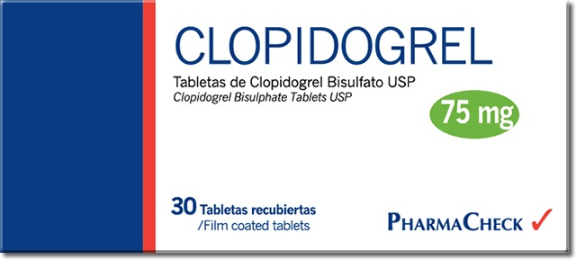
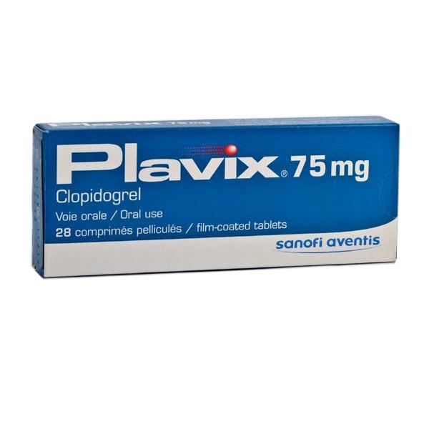
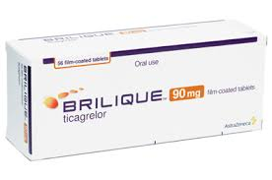
Perioperative management in patients on anti-platelet agents

Slide 16
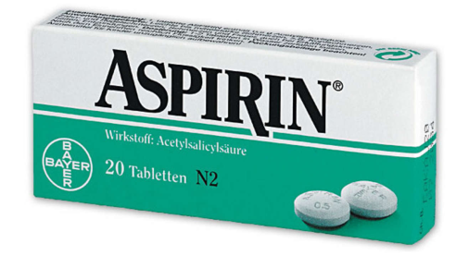
Aspirin
A large meta-analysis (compared peri-procedural withdrawal vs. bleeding risks of aspirin):
Risk of bleeding complications with aspirin was increased by 50%,
but that aspirin did not lead to greater severity of bleeding complications.
In subjects at risk of IHD, aspirin non-adherence/withdrawal tripled the risk of major adverse cardiac events.

Slide 17
Aspirin should be discontinued if the bleeding risk outweighs the potential cardiovascular benefit.
For patients undergoing:
spinal surgery or
certain neurosurgical or
certain ophthalmological operations,
aspirin be discontinued for at least 7 days.

Slide 18
Dual anti-platelet therapy

Slide 19
Dual anti-platelet therapy
5-25% of patients with coronary stents require non-cardiac surgery within 5 years following stent implantation.
To reduce risk of bleeding and transfusion, current Guidelines recommend:
delaying elective non-cardiac surgery until completion of the full course of DAPT
whenever possible, performing surgery without discontinuation of aspirin
Non-cardiac surgery performed early after
Balloon angioplasty is not associated with an increased risk of cardiac events
But, stenting dramatically changes the scenario.

Slide 20
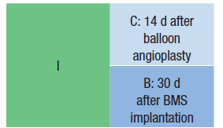
Timing of elective noncardiac surgery in patients with previous PCI
Non-cardiac surgery should be delayed after PCI.

Slide 21
Timing of elective noncardiac surgery in patients with previous PCI
Non-cardiac surgery should optimally be delayed 365 d after DES implantation
Elective non-cardiac surgery after DES implantation may be considered after 180 d.

Slide 22
DAPT and Elective noncardiac surgery
Elective non-cardiac surgery should not be performed in patients in whom DAPT will need to be discontinued perioperatively:
Within 30 d after BMS implantation or
Within 12 mo after DES implantation.
Elective non-cardiac surgery should not be performed:
Within 14 d of balloon angioplasty in patients in whom aspirin will need to be discontinued perioperatively

Slide 23
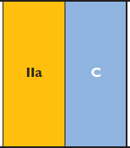
Continuation of P2Y12 inhibitor :
4 weeks after BMS implantation and
3–12 months after DES implantation,
In patients treated with P2Y12 inhibitors, who need to undergo surgery, postponing surgery for:
at least 5 days after cessation of ticagrelor and clopidogrel
7 days in the case of prasugrel

Slide 24
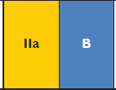
Timing of non-cardiac surgery in cardiac-stable/asymptomatic patients
In patients with recent BMS implantation:
after a minimum of 4 weeks and
ideally 3 months following the intervention.
In patients who have had recent DES implantation
no sooner than 12 months.
This delay may be reduced to 6 months for the new generation DES.
In patients who have had recent balloon angioplasty:
at least 2 weeks.

Slide 25
Urgent non-cardiac surgery
Continue DAPT in patients undergoing urgent noncardiac surgery during the first 4 to 6 wk after BMS or DES implantation, unless the risk of bleeding outweighs the benefit of stent thrombosis prevention.
For patients with a very high risk of stent thrombosis:
bridging therapy with intravenous, reversible glycoprotein inhibitors, such as eptifibatide or tirofiban
Cangrelor, the new reversible intravenous P2Y12-inhibitor
The use of LMWH for bridging in these patients should be avoided.
Dual anti-platelet therapy should be resumed as soon as possible after surgery and, if possible, within 48 hours.

Slide 26
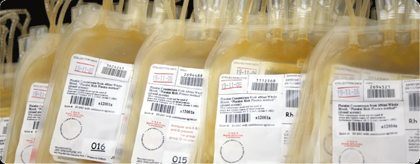
Reversal of anti-platelet therapy
For patients receiving anti-platelet therapy, who have excessive or life-threatening perioperative bleeding, transfusion of platelets is recommended.

Slide 27
Thanks for Your Attention

